Slide 1
THE BLACK ART MOVEMENT
WRITE YOUR NAME HERE

Slide 2
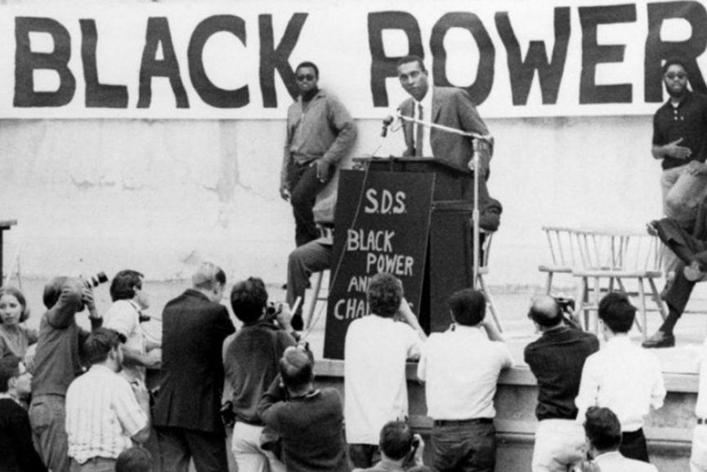
WHO WERE THEY?
The Black Power Movement of the 1960s and 1970s was a political and social movement whose advocates believed in racial pride, self-sufficiency, and equality for all people of Black and African descent.

Slide 3
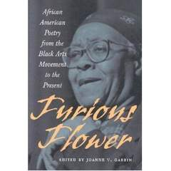
THE BLACK MOVEMNT FORMATION
When the proponent agitators of the black rights went down due to their belief, the infuriated African Americans who were emancipated well enough through education joined to form the movement.

Slide 4
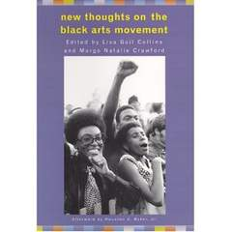
JOYS OF SUCCESSES OF THE MOVEMENT
Though the movement largely associated with composition of men, women such as Maya Angelou largely contributed to its sensitization until it finally achieved recognition from white mainstream acculturation.

Slide 5
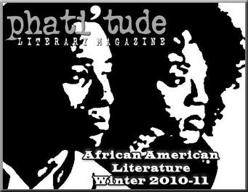
LITERATURE BY THE BLACKS
The biggest causation of this movement was further captured through publications and editorial journals of literature works by the black writers. Their intent boiled in informing the greater black masses of their rights and need to go for them.

Slide 6
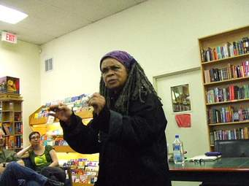
SCHOLARLY MEMBERS OF THE MOVEMENT
This is a movement that was instigated and pioneered by politically motivated black scholarly enthusiasts. It included the writers, the musicians, the dramatists and visual artists.

Slide 7

LITERATURE WORKS OF THE MOVEMENT
Even though these works were innovative and creative, they largely in most cases with bitterness engulfed the representation of blacks on the racist podium; the others were expressive of sexism, anti-Semitic expositions, homophobia and violence.

Slide 8

THE REPRIEVED VOICES
The movement was primarily formed as a way of agitating for the black lives rights and equal treatment among the white mainstream

Slide 9
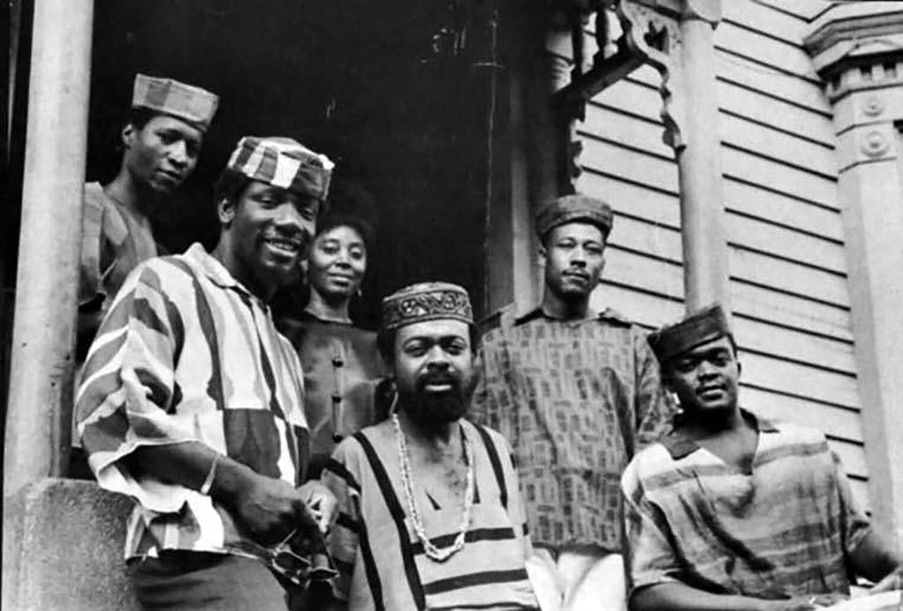
THE DISCIEPLES
The young followers of the movement in New Jersey 1965 were all radiant of the activities of the movements.

Slide 10
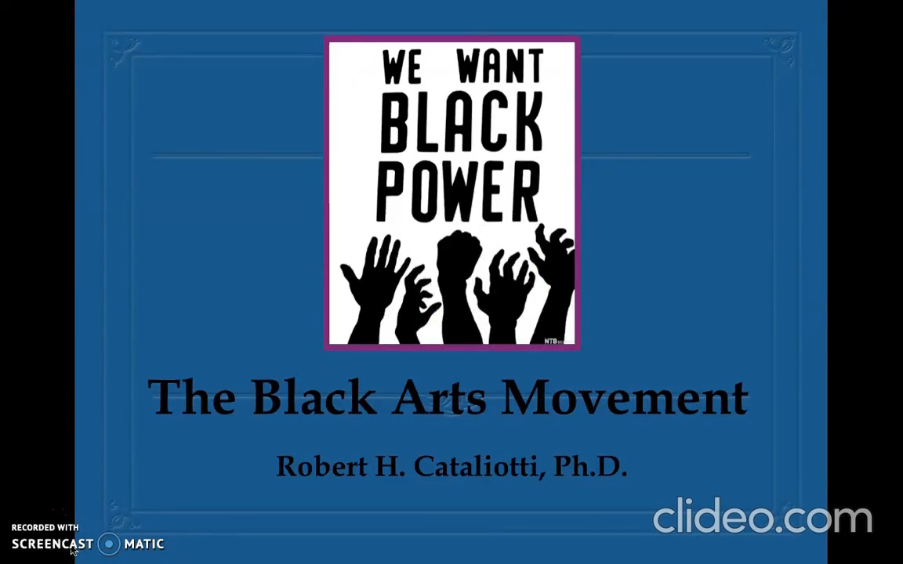
AN OVERVIEW OF THE BLACK ARTS MOVEMENT IN VIDEO

Slide 11
CONCLUSION
In conclusion the Black Arts Movement continued the fight against black infringement from what was known to be substitute to a now modern appreciation of its genesis.

